Slide 1

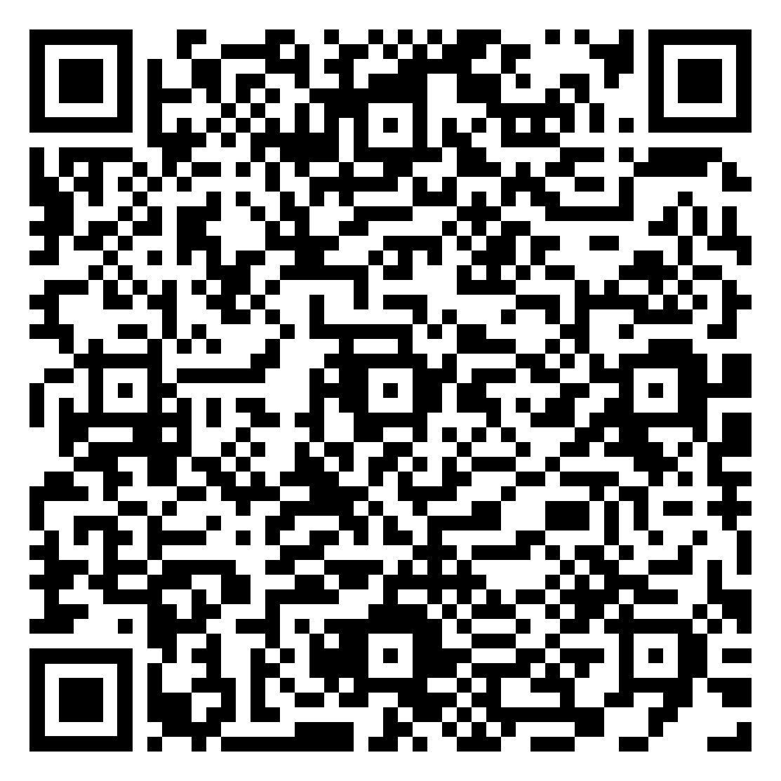




INVITATION
University of KwaZulu Natal (UKZN)
The Department of Higher Education and Training( DHET),
in partnership with the University of KwaZulu Natal (UKZN), invites
you to an International Scholarships Information Session.
l 20 October 2026 l 10:30- 11:30
    REGISTER HERE: https://acesse.one/2ux5x6h
FULLY FUNDED scholarships available in various countries
FIELDS OF STUDY
Wide range of Engineering Sciences, Aerospace, Fuel Cell Development, Nuclear Science, Blue Economy related studies, Green Economy related studies, Computer and Data Sciences, Material Sciences Technology, Veterinary Sciences, Agriculture and Humanities and Social Sciences
…and many more other fields of study
PHD
MASTER’S
BACHELORS
LANGUAGE TRAINING
GET IN TOUCH
internationalscholarships@dhet.gov.za
www.internationalscholarships.dhet.gov.za

